Slide 1
Negotiation skills

Slide 2
Meaning of negotiation
The term negotiation refers to a strategic discussion that resolves an issue in a way that both parties find acceptable.
In a negotiation, each party tries to persuade the other to agree with their point of view. Negotiations involve some give and take, which means one party will always come out on top of the negotiation. The other, though, must concede—even if that concession is nominal.
However, this skill set depends on the work environment, the parties involved and outcome desired. Often, when one party is ready for reaching a compromise, the other party may be resistant. This makes negotiation difficult and you are likely to encounter such situations in the workplace.

Slide 3
Elements of negotiation skills
Communication- Communication is the backbone of negotiation. The way you communicate decides the fate of the negotiation. It involves identifying the nonverbal cues, using the right words and expressing your thoughts in a compelling and engaging way.
Strategizing- There may be instances where the other party disagree with the solution you provide. Good negotiators often come with one or more backup plans. Consider all solutions to the problem before entering a negotiation.

Slide 4
Planning- Proper planning before the negotiation ensures you know the long-term consequences of the negotiation terms. Planning comes in handy during the negotiation process and ensures the successful execution of the decision.
Persuasion- Successful negotiators can influence other parties. Unless you possess the persuasion skills, it becomes difficult to justify how your solution will benefit both parties. Your persuasion skills decide whether the other party agrees to your solution.
Listening- Active listening is the key to a successful negotiation as it ensures that you listen to the other party and understand what they are trying to say.

Slide 5
Problem-solving- Most negotiations occur to find a solution to an issue. With excellent problem-solving skills, you propose viable and intelligent solutions that are beneficial for both parties.
Emotional intelligence- The ability to control and manage your emotions and deal with the other party's emotions differentiates a successful negotiator from an unsuccessful one. People high on emotional intelligence (EI) can accurately perceive and express their emotion, recognize others' emotions and use these emotions to facilitate solutions.

Slide 6
Stages of negotiation
Preparation- The first stage relates to planning and preparation. This is a time to assess the situation and the relationship with the other party. You will want to begin collecting information needed for the negotiations. Important information includes defining your needs and objectives. What are your minimum expectations? How much are you willing to yield? Additionally, what do you anticipate from the other party? What are their needs and objectives? What will they ask for?
Opening and Exchanging information: The process begins with each party laying out and explaining their opening positions. Once initial positions have been exchanged, the parties will explain and justify their positions. It is important to ascertain the other party’s wants and needs.

Slide 7
Bargaining: This stage is the essence of the game of negotiation. Each party will utilize various negotiation strategies to achieve the objectives established during the preparation process. A natural part of the bargaining process is making concessions, in other words, giving up one thing to get something else in return.
Closing and Implementation: This is the final stage of the negotiation process where a final agreement is completed. Both parties should review the terms of the agreement to avoid any misunderstanding. It is important to clarify anything that was left ambiguous or incomplete. In this stage a course of action needs to be developed to implement and monitor the terms of the agreement.

Slide 8
Five styles of negotiation
Competition (win-lose): This style of negotiation considers winning at all costs even at the expense of the other party. Competitive negotiators use hardball tactics to achieve their needs without regard to the other party’s needs. A competitive negotiation style is beneficial when the outcome is important, and the relationship is not.
Collaboration (win-win): In contrast to the competitive style, a collaborative negotiation style seeks a “I win, you win” outcome. This win-win model focuses on making sure all parties have their needs met. With this style, both relationship and outcome are important. The purpose is to maximize outcome and preserve the relationship.

Slide 9
Compromise (split the difference): Unlike the collaborative style, the compromising negotiation style follows a “I win/lose some, you win/lose some” model. Compromising is the style most people think of as negotiation, but it is really only bargaining. Compromisers use this style instead of finding a solution that fully benefits everyone. It may result in satisfying some of each party’s needs, but it does not maximize the situation as collaboration can. However, it can often bring about an unsatisfactory feeling that you gave too much and didn’t get enough in return.

Slide 10
Accommodation (lose-win): This style can be described as the “I lose, you win” model and is the direct opposite of the competitive style. For accommodating negotiators, the relationship means everything and the outcome is not important. The accommodating style might be used in situations where one party has caused harm to another party and needs to repair the relationship.
Avoidance (lose-lose): This style is the “I lose, you lose” model. This style is used when both outcome and relationship are not important. Negotiations can be costly in terms of time and energy. Do the costs of negotiation outweigh the likely outcome and relationship returns? If not, it may be preferable not to negotiate at all.

Slide 11
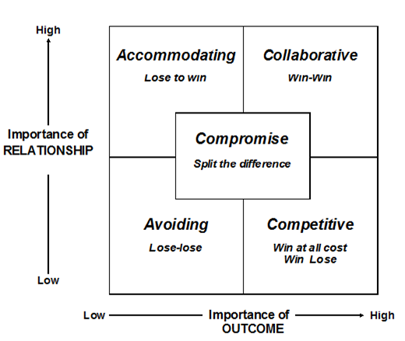

Slide 12
Teamwork

Slide 13
Teamwork is generally understood as the willingness of a group of people to work together to achieve a common aim.
Teamwork suggests that people work in an atmosphere of mutual support and trust, working together cohesively, with good inter-group relations. Each other’s strengths are valued. It should also foster an increasing maturity of relationship, where people are free to disagree constructively, and where both support and challenge are a part of helping teams work.
Teams are formed when individuals with a common taste, preference, liking, and attitude come and work together for a common goal. Teams play a very important role in organizations as well as in our personal lives.

Slide 14
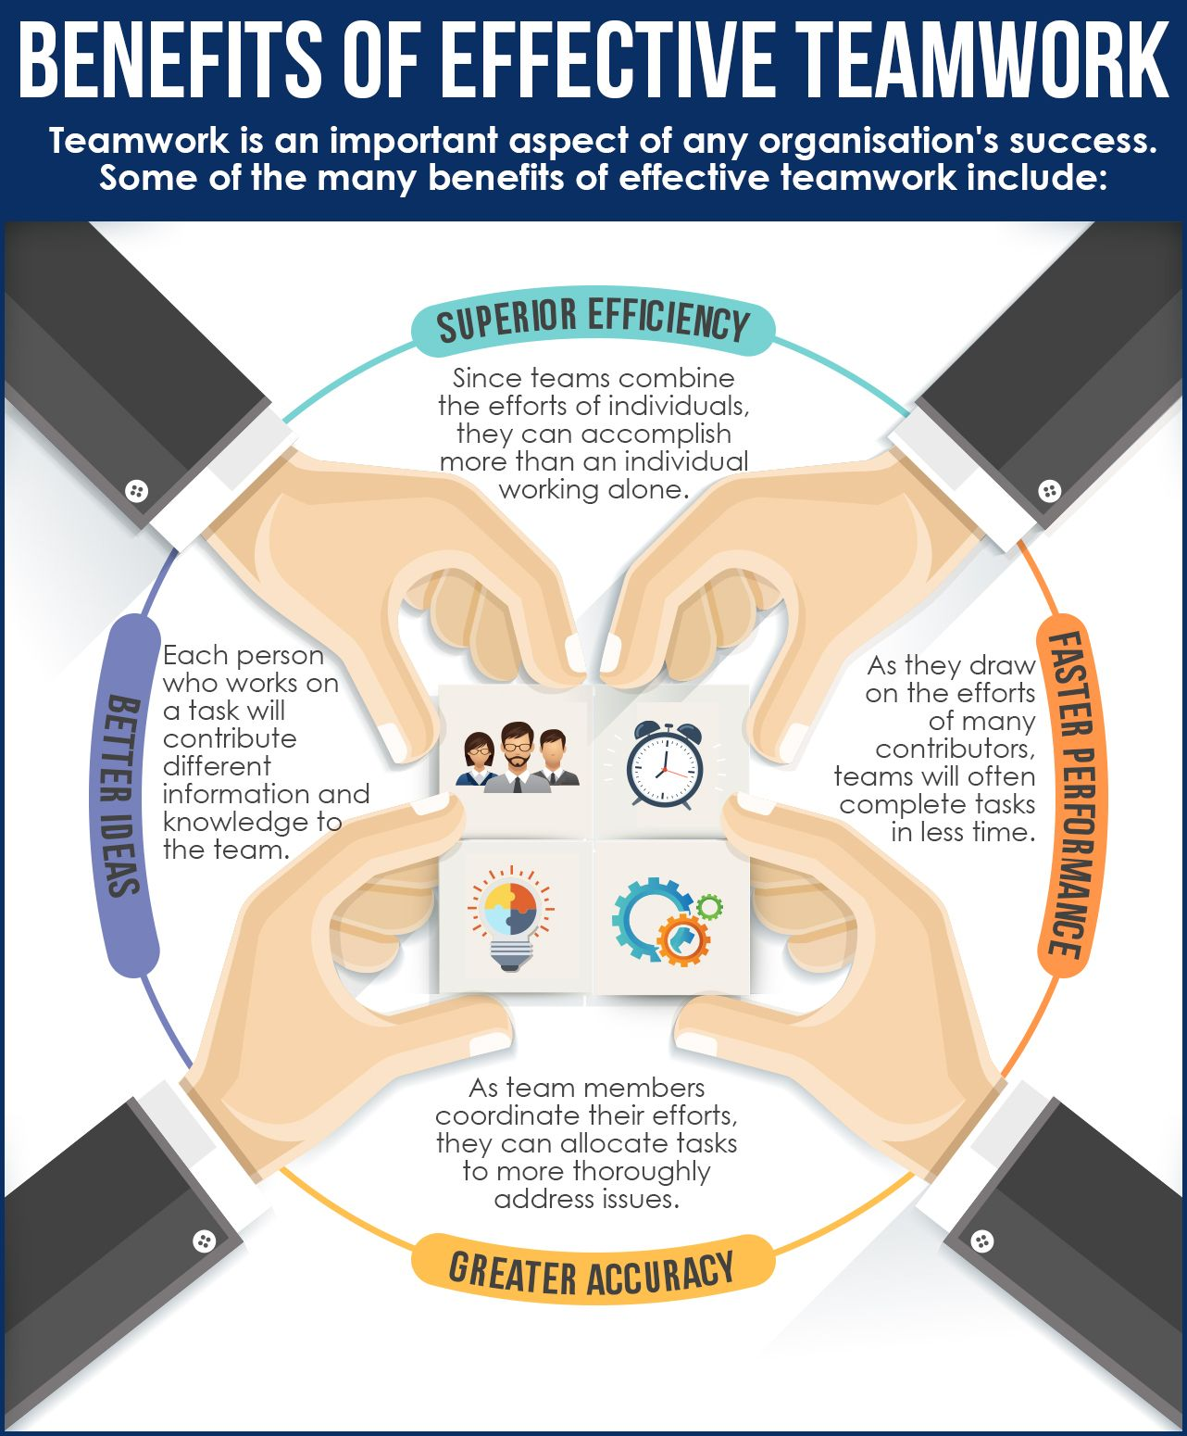

Slide 15
Soft skills required for teamwork
Communication: Effective communication is a two-way street. You must be able to clearly express your ideas, and you need skill in active listening to be able to accurately understand other people’s points of view. You also need to understand when and how to use different communication channels.
Emotional Intelligence: The skill at recognizing and controlling the emotions of others is important in teamwork.
Conflict Management: Differences of opinion will naturally arise within teams. Sometimes those differences become personal as people get annoyed with one another. Conflict management skill means being able to have open discussions without offending someone, and at times intervening when other members of a team look like they are on a collision course.

Slide 16
Negotiation: Sometimes members of a team have different ideas about how to do something. Being able to negotiate means knowing how to bring people together to compromise so that an acceptable solution can be found.

Slide 17
STAGES OF TEAM FORMATION
discovered by Bruce Tuckman in 1965.
This team development framework, according to Tuckman, progresses in a natural and fluid manner, each stage building on the one that preceded it and sometimes—as explained in more detail below—reverting back to a previous stage before moving forward.
These five stages are- Forming, Storming, Norming, Performing, and Adjourning.

Slide 18
Forming- The forming stage of team development is punctuated by excitement and anticipation. Group members are on high alert, each wanting to put their best foot forward while, at the same time, sizing up each other’s strengths and weaknesses.
In this initial phase of group interaction, individual members tend to behave deferentially to one another. Because each new team member sees their role from the perspective of individual performance, the group doesn’t accomplish much during this stage.
This is a good time for the group leader or manager to open up discussions about the team’s mission. It’s also a good time to address the ground rules, clearly stating what the team norms should be while reviewing expectations for team dynamics.

Slide 19
Storming- Storming is where the metaphorical gloves come off, and some team members clash personally, professionally, or both. One team member might take offense at another’s communication style. Work habits might be at odds, and perceptions about who is contributing what—and who might be left holding the bag—begin to surface.
This critical stage is a necessary evil in the formation of a successful team. Managers and team leaders need to confront issues directly. Ignoring them could let minor conflicts fester into major problems. In the end, however, team members will have to come to a consensus about how to move forward as a team.

Slide 20
Norming- You will know your team has entered the norming stage when small conflicts occur less frequently and team members find ways to work together despite differences. Each person begins to recognize how their fellow team members contribute to the group. Some teams will toggle back and forth between the storming and norming stages.
The group needs to work out this dynamic organically. You can gently encourage team members to engage in self-evaluation to determine whether there is room for process improvement, but your primary focus should be on encouraging stability.

Slide 21
Performing- The relationships and interdependencies formed during storming and norming pay off in the performing stage. By now, team members have honed their conflict-resolution abilities and spend less time focused on interpersonal dynamics and more on team effectiveness. This is where surges in creative problem-solving and idea generation occur.
As momentum builds and each team member leans in to the team’s goals, productivity—both personal and collective—begins to increase. This may be the perfect time to evaluate team functions to increase productivity even more.

Slide 22
Adjourning- Often, the adjourning stage brings up bittersweet feelings, as team members go about the business of concluding the group’s functions. They start to focus on the details of completing any deliverables, finalizing documentation, and meeting reporting requirements. They might start looking toward their next assignments, leaving little energy or enthusiasm for finishing the tasks at hand.

Slide 23
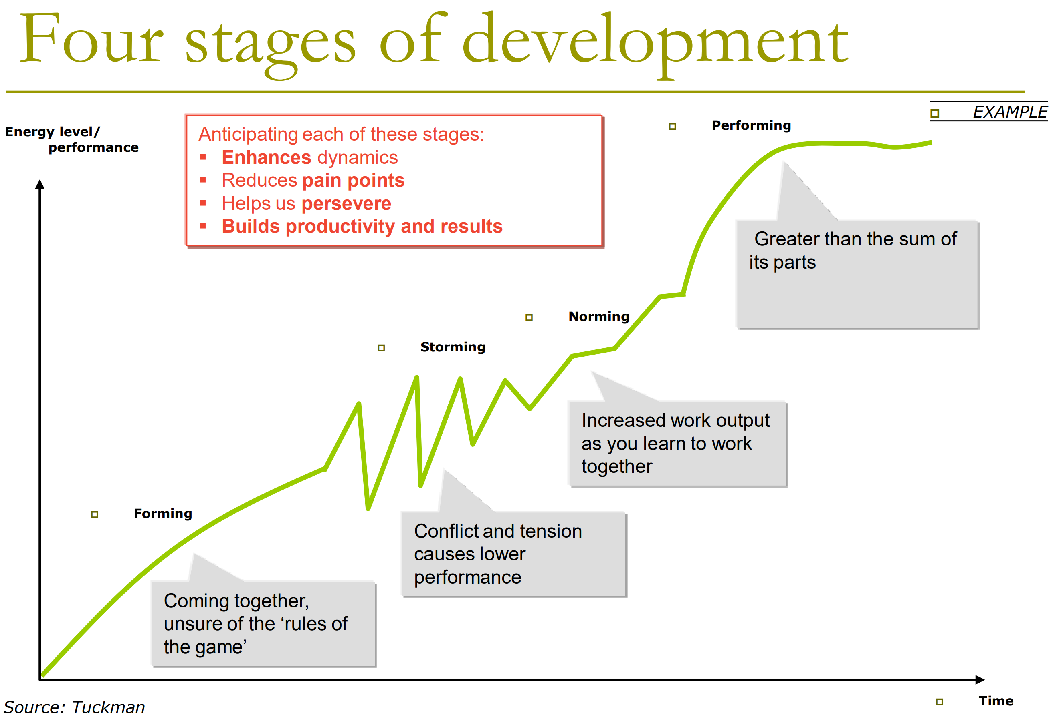

Slide 24
Team building characteristics
Know your people
Choosing the right team members
Having a common goal
Developing teamwork requires commitment
Sharing information
Facilitating open communication
Problem solving
Sharing the outcomes together.

